Slide 1
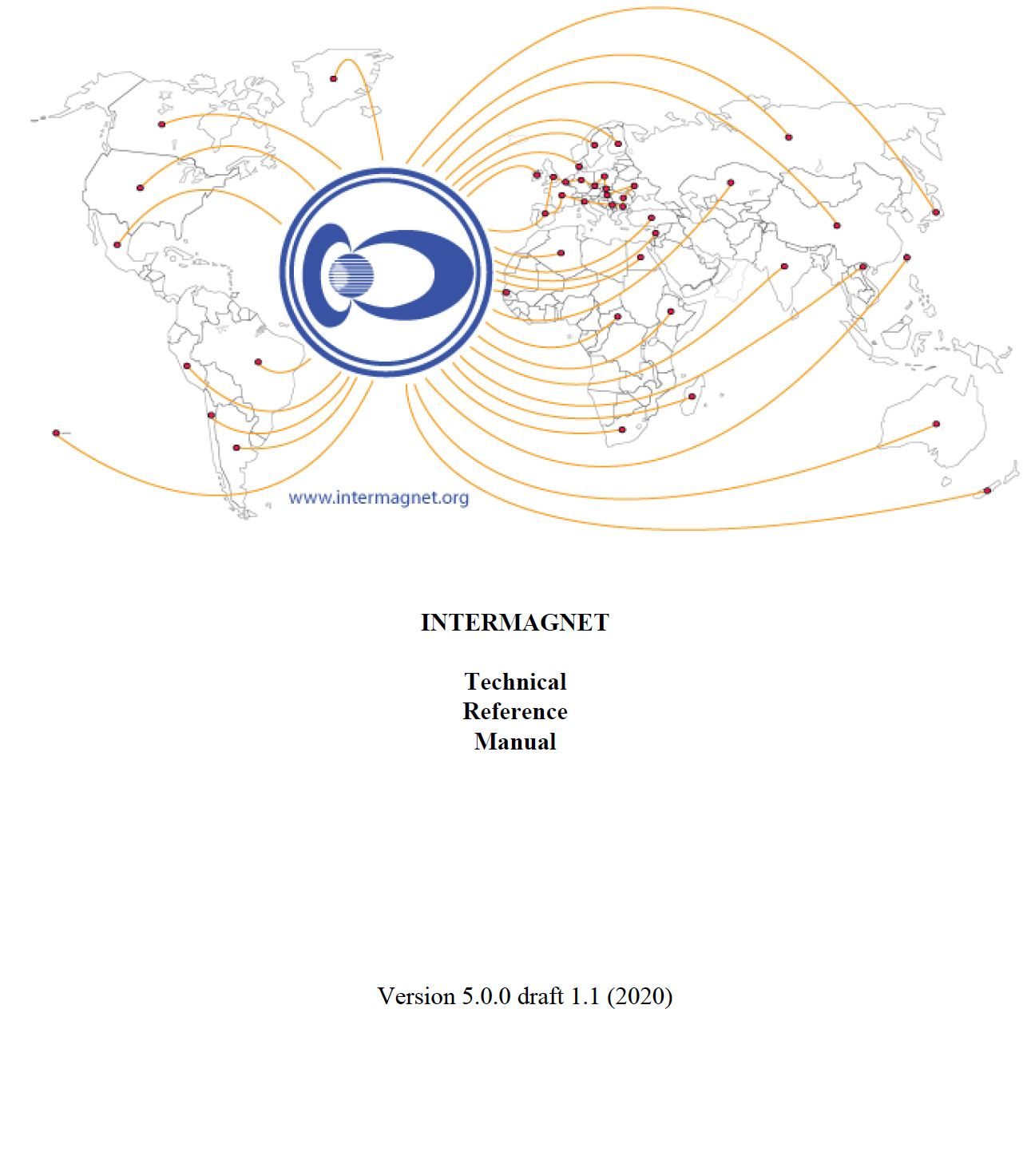

INTERMAGNET Technical Manual
Benoit St-Louis – 2020-07-10

Slide 2
Progress since last meeting in Ottawa
Response from the work group session
Online meeting at the end of 2019
Final decision on the inclusions in TM Version 5.0.0

Slide 3
Technical Manual V5.0.0
Ready for publication!
Final stage
Approval for publication
Distribution through GitHub only

Slide 4
Version number
3 digits
Major
Minor
Corrections/clarifications

Slide 5
Future
DOI
Next and future versions
WEB distribution and integration

Slide 6
Thanks
Wish everyone a successful meeting in this new context of COVID-19.

